Slide 2
DVD
Let’s watch a DVD…
6-2
Notes:
Instructor Notes
Play the Preparation, Cooking, and Serving DVD. Stop the DVD after the “Produce” section has finished playing.

Slide 3
Additional Content
Some other things you should know…
6-3
Notes:
Instructor Notes
Teach the additional content not included in the section of the DVD just watched by using the next several PowerPoint slides.

Slide 4
Using Additives
Food and color additives:
Only use additives approved by your local regulatory authority
NEVER use more additives than are allowed by law
NEVER use additives to alter the appearance of food
Do NOT sell produce treated with sulfites before it was received in the operation
NEVER add sulfites to produce that will be eaten raw
6-4

Slide 5
Presenting Food Honestly
Do NOT use the following to misrepresent the appearance of food:
Food additives or color additives
Colored overwraps
Lights
Food that was not presented honestly must be thrown out.
6-5
Notes:
Instructor Notes
Food must be offered to customers in a way that does not mislead or misinform them. Customers must be able to judge the true appearance, color, and quality of food.

Slide 6
Corrective Actions
Food must be thrown out in the following situations:
When it is handled by staff who have been restricted or excluded from the operation due to illness
When it is contaminated by hands or bodily fluids from the nose or mouth
When it has exceeded the time and temperature requirements designed to keep food safe
6-6
Notes:
Instructor Notes
• Food that has become unsafe must be thrown out unless it can be safely reconditioned. All food—especially ready-to-eat food—must be thrown out in the situations highlighted in the slide.
• Sometimes food can be restored to a safe condition. This is called reconditioning. For example, a hot food that has not been held at the correct temperature may be reheated if it has not been in the temperature danger zone for more than two hours.

Slide 7
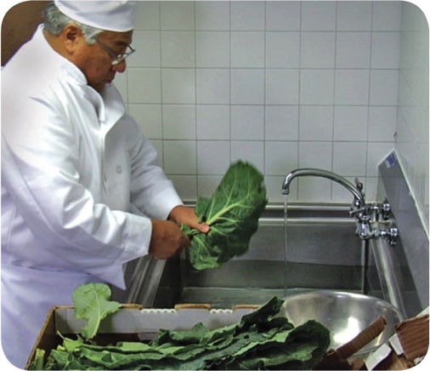
Prepping Produce
Produce can be washed in water containing ozone to sanitize it
Check with your local regulatory authority
When soaking or storing produce in standing water or an ice-water slurry, do NOT mix:
Different items
Multiple batches of the same item
6-7
Notes:
Instructor Notes
Certain chemicals may be used to wash fruits and vegetables. Also, produce can be treated by washing it in water containing ozone. This treatment helps control pathogens. Check your local regulatory requirements.

Slide 8
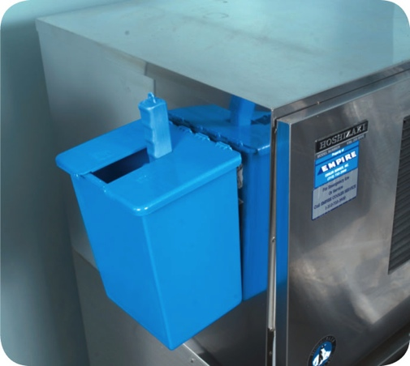
Prepping Ice
NEVER use ice as an ingredient if it was used to keep food cold
Transfer ice using clean and sanitized containers and scoops
NEVER hold ice in containers that held chemicals or raw meat, seafood, or poultry
6-8
Notes:
Instructor Notes
Make ice from water that is safe to drink.
Never use ice as an ingredient if it was used to keep food cold. For example, if ice is used to cool food on a salad bar, it cannot then be used in drinks.

Slide 9
Prepping Ice
Store ice scoops outside ice machines in a clean, protected location
NEVER use a glass to scoop ice or touch ice with hands
6-9

Slide 10
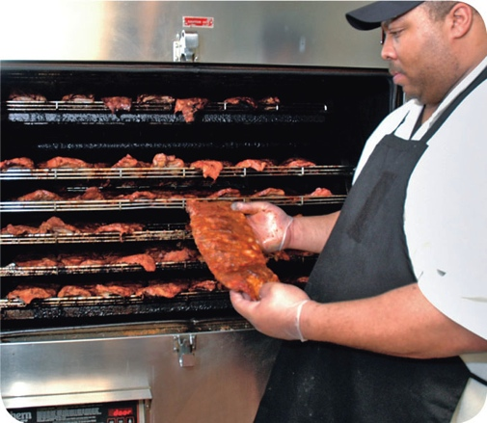
Preparation Practices That Have Special Requirements
You need a variance if prepping food in these ways:
Packaging fresh juice on-site for sale at a later time, unless the juice has a warning label
Smoking food to preserve it but not to enhance flavor
Using food additives or components to preserve or alter food so it no longer needs time and temperature control for safety
Curing food
6-10
Notes:
Instructor Notes
You will need a variance when prepping food in certain ways. A variance is a document issued by your regulatory authority that allows a regulatory requirement to be waived or changed.
When applying for a variance, your regulatory authority may require you to submit a HACCP plan. The plan must account for any food safety risks related to the way you plan to prep the food item.

Slide 11
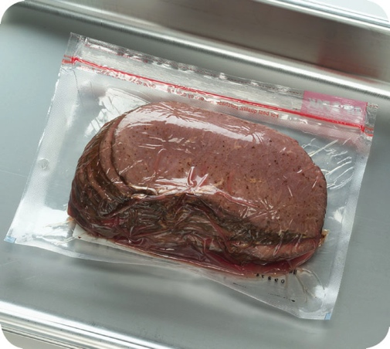
Preparation Practices That Have Special Requirements
You need a variance if prepping food in these ways:
Packaging food using a reduced-oxygen packaging (ROP) method
Sprouting seeds or beans
Offering live shellfish from a display tank
Custom-processing animals for personal use (i.e., dressing a deer)
6-11
Notes:
Instructor Notes
Clostridium botulinum and Listeria monocytogenes are risks to food packaged using a reduced-oxygen packaging method. This includes MAP, vacuum-packed and sous vide food.

Slide 12
Review
Let’s review
6-12
Notes:
Instructor Notes
Review the content presented using the next several PowerPoint slides.

Slide 13
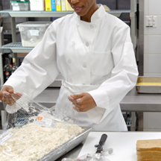
Review
What’s wrong with this picture?
6-13
Notes:
Instructor Notes
The chef has taken out too much tuna salad for the number of sandwiches she is going to make. This exposes more tuna salad to the temperature danger zone than is necessary.
Only remove as much food from the cooler as you can prep in a short period of time. This keeps ingredients from sitting out for long periods of time.

Slide 14
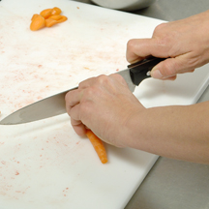
Review
What’s wrong with this picture?
6-14
Notes:
Instructor Notes
The food handler appears to be prepping the carrots on a cutting board used to prep another product, possibly raw meat. This can lead to cross-contamination and illness.
Make sure workstations, cutting boards, and utensils are clean and sanitized.

Slide 15
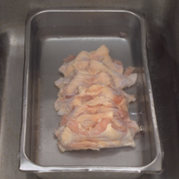
Review
What’s wrong with this picture?
6-15
Notes:
Instructor Notes
This frozen chicken is being thawed incorrectly. It is simply being submerged in water.
If the chicken is going to be thawed in this manner, it must meet these requirements.
Submerge it under running, drinkable water at 70ºF (21ºC) or lower. The flow of the water must be strong enough to wash loose food bits into the drain.
Always use a clean and sanitized food-prep sink when thawing food this way.
Never let the temperature of the food go above 41ºF (5ºC) for longer than four hours. This includes the time it takes to thaw the food plus the time it takes to prep or cool it.

Slide 16
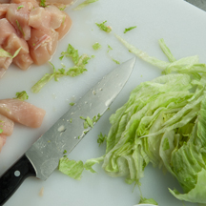
Review
What’s wrong with this picture?
6-16
Notes:
Instructor Notes
The lettuce, a ready-to-eat food, is being prepped on the same board as the raw chicken. This is can lead to cross-contamination.
Make sure that fruit and vegetables do not touch surfaces exposed to raw meat, seafood, or poultry.

Slide 17
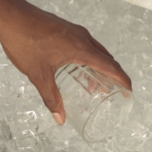
Review
What’s wrong with this picture?
6-17
Notes:
Instructor Notes
The food handler is using a glass to scoop ice. This could result in the physical contamination of the ice if the glass were to break.
Never use a glass to scoop ice or touch ice with bare hands.

Slide 18
DVD
Let’s watch a DVD…
6-18
Notes:
Instructor Notes
Play the “Cooking”, “Cooling”, and “Reheating” sections of the Preparation, Cooking, and Serving DVD. Stop the DVD after the “Reheating” section has finished playing.

Slide 19
Additional Content
Some other things you should know…
6-19
Notes:
Instructor Notes
Teach the additional content not included in the section of the DVD just watched using the next several PowerPoint slides.

Slide 20
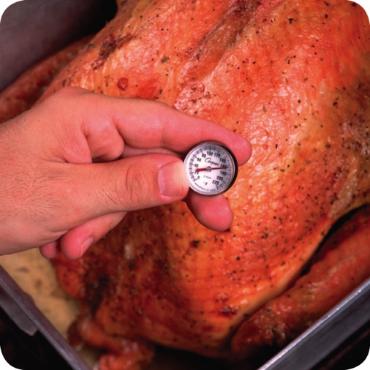
Cooking Requirements for Specific Food
Minimum internal cooking temperature:
165ºF (74ºC) for 15 seconds
Poultry—whole or ground chicken, turkey, or duck
Stuffing made with fish, meat, or poultry
Stuffed meat, seafood, poultry, or pasta
Dishes that include previously cooked, TCS ingredients
6-20

Slide 21
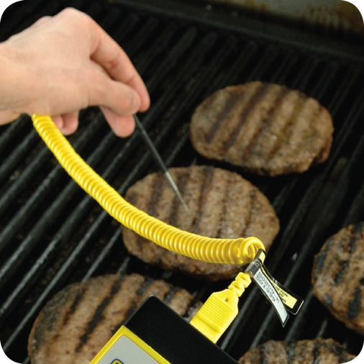
Cooking Requirements for Specific Food
Minimum internal cooking temperature:
155ºF (68ºC) for 15 seconds
Ground meat—beef, pork, and other meat
Injected meat—including brined ham and flavor-injected roasts
Mechanically tenderized meat
Ratites, including ostrich and emu
Ground seafood—including chopped or minced seafood
Shell eggs that will be hot-held for service
6-21

Slide 22
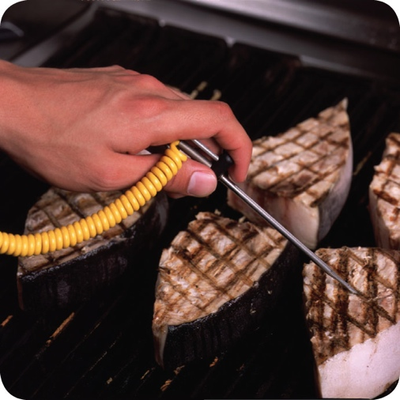
Cooking Requirements for Specific Food
Minimum internal cooking temperature:
145ºF (63ºC) for 15 seconds
Seafood—including fish, shellfish, and crustaceans
Steaks/chops of pork, beef, veal, and lamb
Commercially raised game
Shell eggs that will be served immediately
6-22

Slide 23
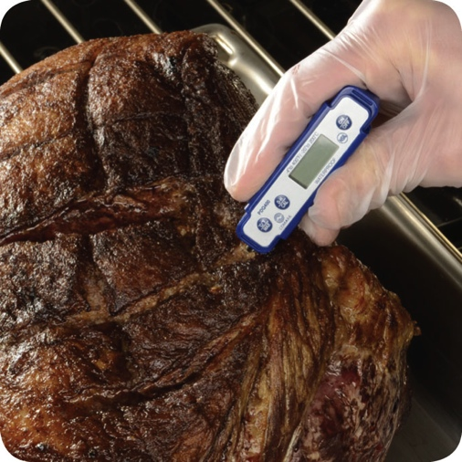
Cooking Requirements for Specific Food
Minimum internal cooking temperature:
145ºF (63ºC) for 4 minutes
Roasts of pork, beef, veal, and lamb
Alternate cooking times/temperatures
130ºF (54ºC) 112 minutes
131ºF (55ºC) 89 minutes
133ºF (56ºC) 56 minutes
135ºF (57ºC) 36 minutes
136ºF (58ºC) 28 minutes
138ºF (59ºC) 18 minutes
140ºF (60ºC) 12 minutes
142ºF (61ºC) 8 minutes
144ºF (62ºC) 5 minutes
6-23

Slide 24
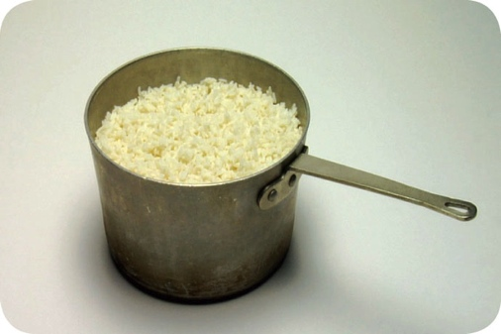
Cooking Requirements for Specific Food
Minimum internal cooking temperature:
135ºF (57ºC)
Fruit, vegetables, grains (rice, pasta), and legumes (beans, refried beans) that will be hot-held for service
6-24

Slide 25
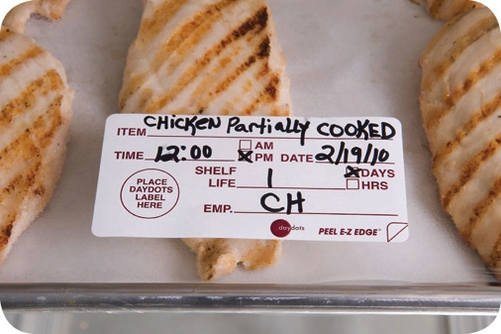
Partial Cooking During Preparation
If partially cooking meat, seafood, poultry, or eggs or dishes containing these items:
NEVER cook the food longer than 60 minutes during initial cooking
Cool the food immediately after initial cooking
Freeze or refrigerate the food after cooling it
Heat the food to at least 165˚F (74˚C) for 15 seconds before selling or serving it
Cool the food if it will not be served immediately or held for service
6-25
Notes:
Instructor Notes
Some operations partially cook food during prep and then finish cooking it just before service. You must follow the steps in the slide if you plan to partially cook meat, seafood, poultry, or eggs; or dishes containing these items.
Your local regulatory authority may require you to have written procedures that explain how the food cooked by this process will be prepped and stored. These procedures must be approved by the regulatory authority and describe the following:
How the requirements will be monitored and documented
Which corrective actions will be taken if requirements are not met
How these food items will be marked after initial cooking to indicate that they need further cooking
How these food items will be separated from ready-to-eat food during storage, once initial cooking is complete

Slide 26
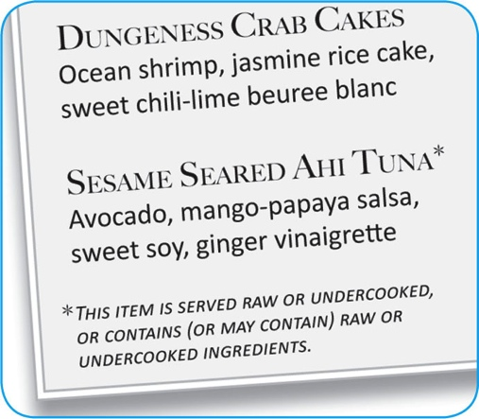
Consumer Advisories
If your menu includes raw or undercooked TCS items, you must:
Note it on the menu next to the items
Asterisk the item
Place a footnote at the menu bottom indicating the item is raw, undercooked, or contains raw or undercooked ingredients
Advise customers who order this food of the increased risk of foodborne illness
Post a notice in the menu
Provide this information using brochures, table tents, or signs
6-26
Notes:
Instructor Notes
If your menu includes TCS items that are raw or undercooked, you must note it on the menu next to these items. This can be done by placing an asterisk next to the item that points customers to a footnote at the bottom of the menu. The footnote must include a statement that indicates the item is raw or undercooked, or contains raw or undercooked ingredients.
You must advise customers who order food that is raw or undercooked of the increased risk of foodborne illness. You can do this by posting a notice in your menu. You can also provide this information using brochures, table tents, signs, or other written methods.

Slide 27
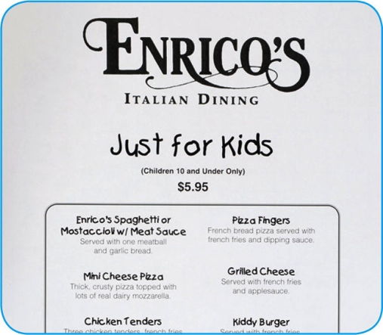
Consumer Advisories
The FDA advises against offering these items on a children’s menu if they are raw or undercooked:
Meat
Poultry
Seafood
Eggs
6-27
Notes:
Instructor Notes
The Food and Drug Administration (FDA) advises against offering raw or undercooked meat, poultry, seafood, or eggs on a children’s menu. This is especially true for undercooked ground beef, which may be contaminated with enterohemorrhagic and shiga toxin-producing E. coli O157:H7.

Slide 28
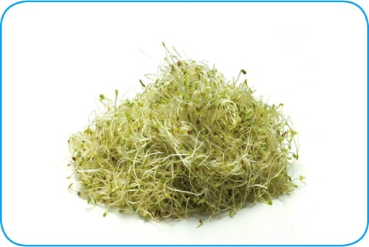
Operations That Mainly Serve High-Risk Populations
NEVER serve:
Raw seed sprouts
Raw or undercooked eggs, meat, or seafood
Over-easy eggs
Raw oysters on the half shell
Rare hamburgers
6-28

Slide 29
Storing Food for Further Cooling
When storing food for further cooling:
Loosely cover food containers before storing them
Food can be left uncovered if protected from contamination
Storing uncovered containers above other food, especially raw seafood, meat, and poultry, will help prevent cross-contamination
6-29
Notes:
Instructor Notes
Loosely cover food containers before storing them. Food can be left uncovered if stored in a way that prevents contaminants from getting into it. Storing uncovered containers above other food, especially raw seafood, meat, and poultry, will help prevent cross-contamination.

Slide 30
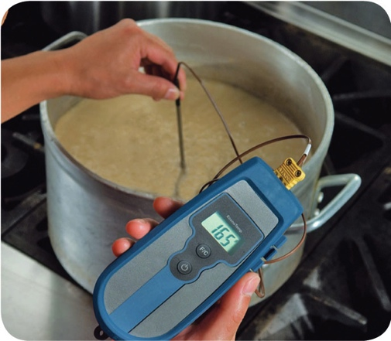
Reheating Food
Food reheated for immediate service:
Can be reheated to any temperature if it was cooked and cooled correctly
Food reheated for hot-holding:
Must be reheated to an internal temperature of 165ºF (74ºC) for 15 seconds within two hours
Reheat commercially processed and packaged ready-to-eat food to an internal temperature of at least 135ºF (57ºC)
6-30
Notes:
Instructor Notes
These guidelines apply to all heating methods, including ovens and microwave ovens.

Slide 31
Review
Let’s review
6-31
Notes:
Instructor Notes
Review the content just presented using the next several PowerPoint slides.
To ensure that everyone in class participates, pass out index cards with the letters A, B, C, and D on them. Have each student answer each question by holding up the correct letter.

Slide 32
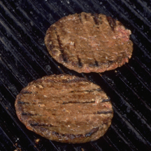
Review
What is the minimum internal cooking temperature?
A. 165ºF (74ºC) for 15 seconds
B. 155ºF (68ºC) for 15 seconds
C. 145ºF (63ºC) for 15 seconds
D. 135ºF (57ºC) for 15 seconds
Ground meat
6-32
Notes:
Instructor Notes
The answer is B. Ground meat, including beef, pork, and other meat, must be cooked to 155ºF (68ºC) for 15 seconds.

Slide 33
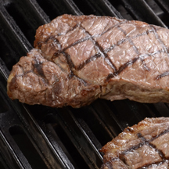
Review
What is the minimum internal cooking temperature?
A. 165ºF (74ºC) for 15 seconds
B. 155ºF (68ºC) for 15 seconds
C. 145ºF (63ºC) for 15 seconds
D. 135ºF (57ºC) for 15 seconds
Beef steak
6-33
Notes:
Instructor Notes
The answer is C. Steak/chops of pork, beef, veal, and lamb must be cooked to 145ºF (63ºC) for 15 seconds.

Slide 34
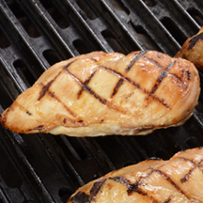
Review
What is the minimum internal cooking temperature?
A. 165ºF (74ºC) for 15 seconds
B. 155ºF (68ºC) for 15 seconds
C. 145ºF (63ºC) for 15 seconds
D. 135ºF (57ºC) for 15 seconds
Poultry
6-34
Notes:
Instructor Notes
The answer is A. Poultry, including whole or ground chicken, must be cooked to a minimum internal temperature of 165ºF (74ºC) for 15 seconds.

Slide 35
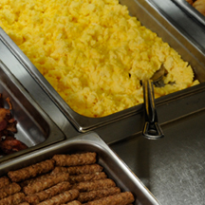
Review
What is the minimum internal cooking temperature?
A. 165ºF (74ºC) for 15 seconds
B. 155ºF (68ºC) for 15 seconds
C. 145ºF (63ºC) for 15 seconds
D. 135ºF (57ºC) for 15 seconds
Shell eggs for hot-holding
6-35
Notes:
Instructor Notes
The answer is B. Shell eggs that will be hot-held for service must be cooked to a minimum internal temperature of 155ºF (68ºC) for 15 seconds.

Slide 36
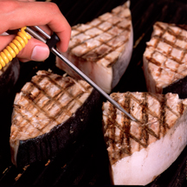
Review
What is the minimum internal cooking temperature?
A. 165ºF (74ºC) for 15 seconds
B. 155ºF (68ºC) for 15 seconds
C. 145ºF (63ºC) for 15 seconds
D. 135ºF (57ºC) for 15 seconds
Swordfish
6-36
Notes:
Instructor Notes
The answer is C. Seafood, including fish, shellfish, and crustaceans must be cooked to a minimum internal temperature of 145ºF (63ºC) for 15 seconds.

Slide 37
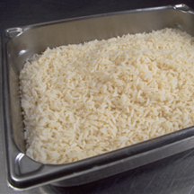
Review
What is the minimum internal cooking temperature?
A. 165ºF (74ºC)
B. 155ºF (68ºC)
C. 145ºF (63ºC)
D. 135ºF (57ºC)
Cooked rice
6-37
Notes:
Instructor Notes
The answer is D. Fruit, vegetables, grains (rice, pasta), and legumes (beans, refried beans) that will be hot-held for service must be cooked to a minimum internal temperature of 135ºF (57ºC).

Slide 38
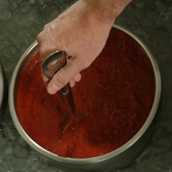
Review
Meat sauce was cooled from 135ºF to 70ºF (57ºC to 21ºC) in 1 hour and then from 70ºF to 41ºF (21ºC to 5ºC) in 4 hours. Was it cooled correctly?
A. Yes
B. No
6-38
Notes:
Instructor Notes
The answer is A. Food must be cooled from 135ºF to 70ºF (57ºC to 21ºC) within two hours and then from 70ºF to 41ºF (21ºC to 5ºC) or lower in the next four hours.

Slide 39
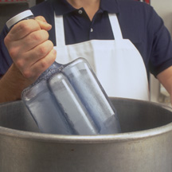
Review
Chili was cooled from 135ºF to 70ºF (57ºC to 21ºC) in 2 hours and then from 70ºF to 41ºF (21ºC TO 5ºC) in 4 hours. Was it cooled correctly?
A. Yes
B. No
6-39
Notes:
Instructor Notes
The answer is A. Food must be cooled from 135ºF to 70ºF (57ºC to 21ºC) within two hours and then from 70ºF to 41ºF (21ºC to 5ºC) or lower in the next four hours.

Slide 40
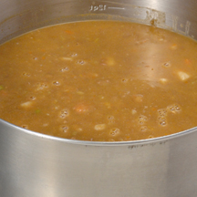
Review
Soup was reheated to 165ºF (74ºC) for 15 seconds within 4 hours. Was it reheated correctly?
A. Yes
B. No
6-40
Notes:
Instructor Notes
The answer is B. TCS food that will be reheated for hot-holding must be reheated to an internal temperature of 165ºF (74ºC) for 15 seconds within two hours.

